Slide 1


SMART INDIA HACKATHON 2025
TITLE PAGE
Problem Statement ID – SIH26073
Problem Statement Title – Anomaly Detection for Automatic Weather Stations
Theme- Disaster Management
PS Category- Software
Team ID- AIML36
Team Name - Future

Slide 2
AWSense
Future
Proposed Solution (Describe your Idea/Solution/Prototype)
The Problem
Automatic Weather Stations measure temperature, pressure, humidity continuously.
Sensor malfunctions go undetected, corrupting critical weather data.
False data leads to inaccurate forecasts and delayed disaster warnings.
Our Solution
Real-time anomaly detection system that identifies sensor failures instantly.
Distinguishes genuine weather events from sensor malfunctions.
Generates alerts with confidence scores and sensor health metrics.
Detect abnormal sensor behaviour without incorrectly rejecting genuine weather events.

Slide 3
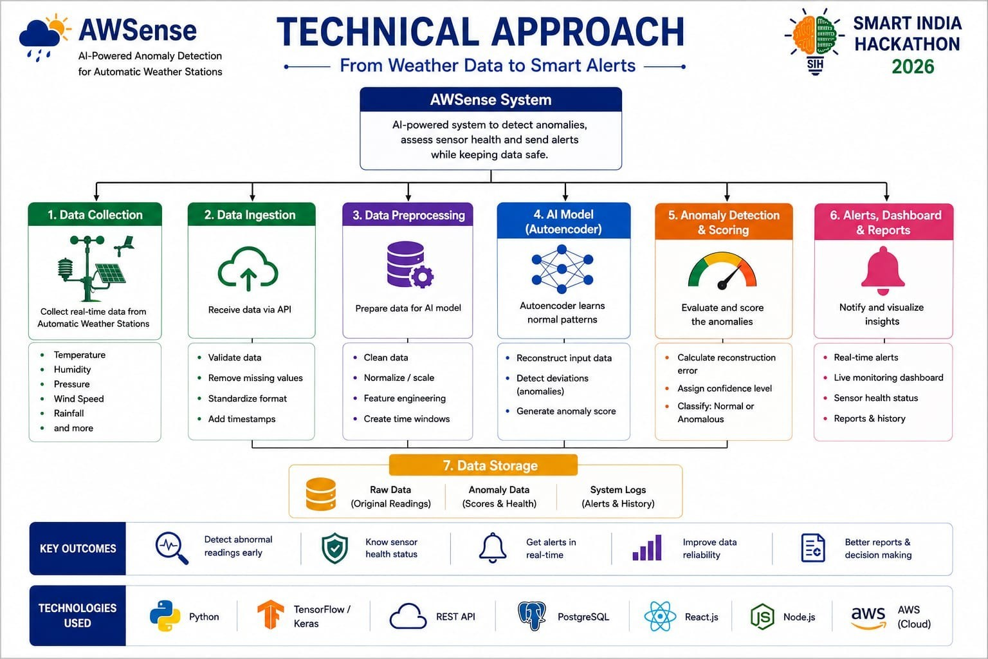

Slide 4
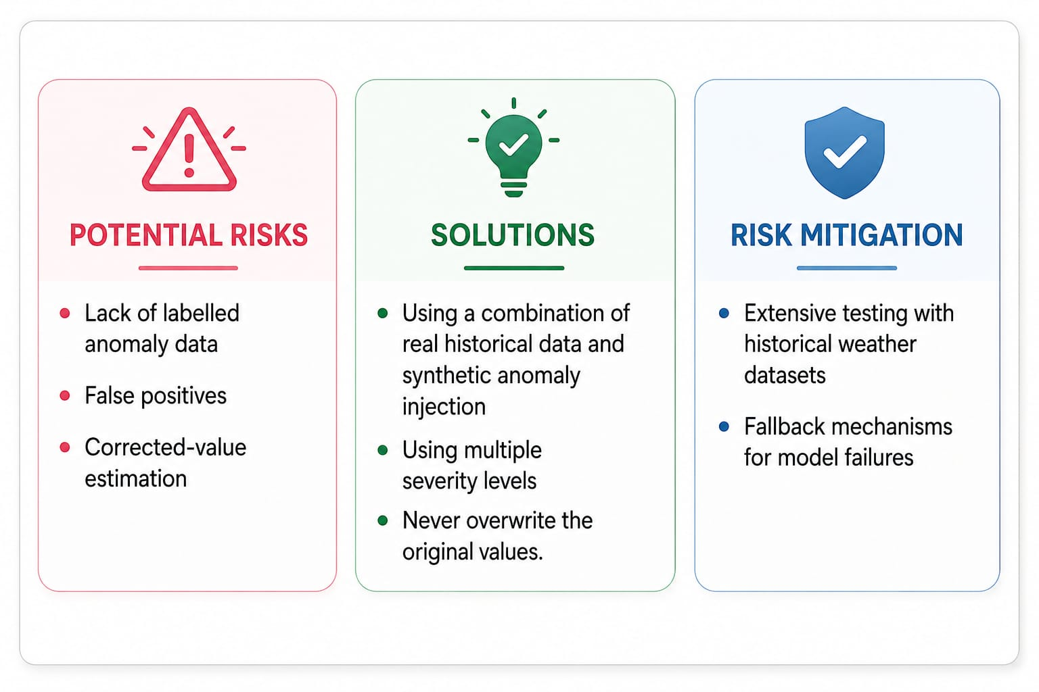
Future
FEASIBILITY AND VIABILITY

Slide 5
IMPACT AND BENEFITS
Future
Disaster Management
Early detection of sensor failures prevents false alarms and missed warnings
Improves accuracy of weather forecasts and disaster preparedness
Broader Impact
Social: Saves lives through reliable early warning systems
Economic: Reduces losses from weather-related disasters
Environmental: Enables better climate monitoring and research

Slide 6
Future
RESEARCH AND REFERENCES
Year
Research / Reference
Technique / Focus
Key Finding / Relevance to AWSense
Link
Afif & Meganendra – Predictive Maintenance for AWS Based on Anomaly Detection Using Autoencoder
Shows how Autoencoders detect abnormal AWS readings to support predictive maintenance. Directly backs the AWSense ML approach.
2023
Autoencoder + anomaly detection
link
2021 | Nassif et al. – Machine Learning for Anomaly Detection: A | Reviews ML anomaly-detection methods and highlights | link
 | Systematic Review
2021 | Ioannou et al. – Low-Cost Automatic Weather Stations in | _{AWS + IoT + Deep Learning} Demonstrates how AWS systems use IoT, real-time data, edge computing, and AI/Deep Learning for weather monitoring. | link
 | the Internet of Things
2021 | Davari et al. – A Survey on Data-Driven Predictive | _{ML/DL + Predictive Maintenance} Explains how sensor data and anomaly detection support predictive maintenance and early fault detection. | link
 | Maintenance
ML-based anomaly detection
unsupervised approaches, supporting the AWSense strategy.

